Slide 1
Performance Pay and Multidimensional Sorting: Productivity, Preferences, and Gender
By THOMAS DOHMEN AND ARMIN FALK
American Economic Review 101(April 2011):556-590

Slide 2
CONTENTS
Introduction
Experiment
Results
Discussion

Slide 3
PART 1: Introduction
Background
Approach
Research Questions

Slide 4
Introduction · Backgroud
Providing proper incentive schemes is important for tackling a contract enforcement problem.
Fixed-payment scheme v.s. variable-payment scheme
Worker self-election is likely to depend both on the incentive effect per se and the sorting effect.
Little is known empirically about the nature of the selction/sorting process.

Slide 5
Introduction · Approach
field data v.s. experimental data
Relevant data in difficult to obtain in the field.
Experiments offer a valuable tool for studying incentives and sorting in a controlled environment.
Define material incentives
Measure individual productivity,characteristics and preferences
Mix implicit or explicit incentives
Eliminate influence of timing

Slide 6
Introduction · Research Questions
Which personal characteristics beyond individual productivity differences provoke workers to self-select into variable instead of fixed-pay contracts?

Slide 7
PART 2: Experiment
Work Task
Design
Procedure

Slide 8
Experiment · Work Task
Multiply one-digit numbers by two-digit numbers
real effort task
no previous knowledge required
easy to explain
enough heterogeneity in productivity
proxy for general cognitive ability
Five different degrees of difficulty
level 1: 11 x 9
level 2: 3 x 32
level 3: 6 x 43
level 4: 4 x 68
level 5: 7 x 89

Slide 9
Experiment · Design · Beginning
The same number of females and males were invited to one session.
12 men and 12 women
the first 20 subjects participated in the session
anonymous
A written overview were handed out to subjects.
the work task
a basic structure of the experiment
no aids allowed for answering the problems
Most instuctions were presented on the computer screen.

Slide 10

Experiment · Work Task
00 : 23
Problem 1:
4 x 68=
OK

Slide 11
Experiment · Work Task · If True
00 : 47
Problem 2:
5 x 72=
OK

Slide 12
Experiment · Work Task · If Flase
00 : 56
Problem 2:
5 x 72=
OK

Slide 13
Experiment · Design · Step 1
Calculate one multiplication problem as fast as possible.
The problem had a degree of difficulty 4.
No payment was involved.
The time used is Productivity Indicator 1.

Slide 14
Experiment · Design · Step 2
Calculate one multiplication problem as fast as possible.
The problem had a degree of difficulty 4.
Endowment:150 points
5 points would be substracted per seconds.
The time used is Productivity Indicator 2.

Slide 15
Experiment · Design · Step 3
Calculate problems in 5 minutes.
The problems had different difficulty levels with random sequence which is same for each subject.
10 points per correct answer.
The number is Productivity Indicator 3.

Slide 16
Experiment · Design · Step 4
Assess performance in step 3 by themselves.
How much effort did you exert?
How stressed did you feel?
How exhausted did you get?
Answer these questions on a seven-point Likert scale.
1: not at all
7: very much

Slide 17
Experiment · Design · Step 5
Assessed performance in step 3 relative to others’ performance.
How many of the other 19 participants solved more questions than you did?
Have incentives to answer accurately.
a correct estimate: 100 points
a estimate within 1: 50 points
other conditions: 0 points

Slide 18
Experiment · Design · Step 6
Choose between a variable contract and a fixed-payment contract.
the fixed-pay scheme:
w_{i}^{F} = 400
the variable-pay sheme – peice rate
w_{i}^{PR} = 10x_{i}
the variable-pay sheme – tournament
the variable-pay sheme – revenue sharing
w_{i}^{PR} = 10(x_{i} +x_{i} )/2
1300
1300 (p=0.5) or 0 (p=0.5)
0
w_{i}^{T} =

Slide 19
Experiment · Design · Step 7
Ask how they would have decided if the fixed payment different.
prefer the treatment-specific variable pay or the fixed payment
{ 50,100,150,……,800}

Slide 20
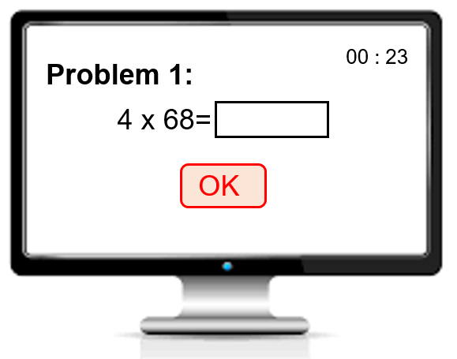
Experiment · Design · Step 8
Work for 10 minutes on the same task as step 3.

Slide 21
Experiment · Design · Step 9
Assess performance in step 8.
How much effort did you exert?
How stressed did you feel?
How exhausted did you get?
Answer these questions on a seven-point Likert scale.
1: not at all
7: very much

Slide 22
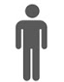
Experiment · Design · Step 10
Elicit social preferences using a simple Trust game.
A two-player,sequential game
(1) contingent response method
(2）the actual transfer
(3）both roles required
(1) transfer amount {0,20,40,60,80,100,120}
(2) tranfer tripled; tranfer any amount[0,480]
the first mover
endowment:120 points
the second mover
endowment:120 points
More details see: Berg et al.(1995)

Slide 23
Experiment · Design · Step 11
Elicit risk preferences using simple lottery choices.
make a decision for each row
determine a row randomly for payment.
row | choice A | choice B
1 | 25 | (400,0)
2 | 50 | (400,0)
3 | 75 | (400,0)
4 | 100 | (400,0)
5 | 125 | (400,0)
6 | 150 | (400,0)
7 | 175 | (400,0)
8 | 200 | (400,0)
9 | 225 | (400,0)
10 | 250 | (400,0)
11 | 275 | (400,0)
12 | 300 | (400,0)
13 | 325 | (400,0)
14 | 350 | (400,0)
15 | 375 | (400,0)
More details see: Hault & Laury.(2002)

Slide 24
Experiment · Design · Step 12
Elicit risk attitude on an 11-point scale.
How do you see yourself: “Are yougenerally a person who is fully prepared to take risks or do you try to avoid taking risks? Please tick a box on thescale, where the value 0 means: ‘unwilling to take risks’ and the value 10 means: ‘fully prepared to take risks’.” (by 2004 wave of the German Socio-Economic Panel Study)
Answer these questions on a seven-point Likert scale.
0: unwilling to take risks
10: fully prepared to take risks

Slide 25
Experiment · Design · Final Questinare
Socioeconomic characteristics
gender,age,nationality,marital status, and parents’ eduction
Educational achievement
grades and major field of Abitur (university entrance examination)
high school graduation year
last mathematical grade in high school
Verbal IQ test
Personal attitudes test

Slide 26

Experiment · Design · Brief Summary
Productivity Indicators
step 1, 2, 3
assessment
step 4, 5
sorting experiment
(decision, strategetic change,game)
step 6, 7, 8
personal information
step 9,10,11,12

Slide 27
Experiment · Procedure
Subjects: students from the University of Bonn
360 subjects in total
Software: z-Tree
About 90 minutes for 1 session
18 sessions for 3 treatments
10 points=0.17 euros (about 1.4 RMB now)
Average earnings:21.20 euros (about 166.5 RMB now)

Slide 28
PART 3: Results
Output
Sorting

Slide 29
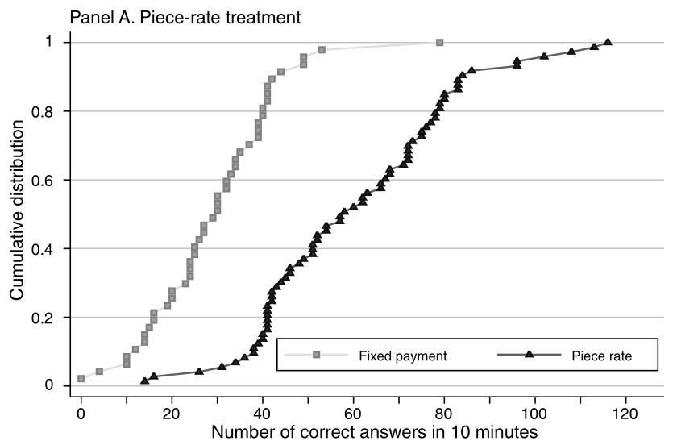
Results · Output · Numbers
The piece-rate scheme is significantly higher than that under the fixed-wage regime.

Slide 30
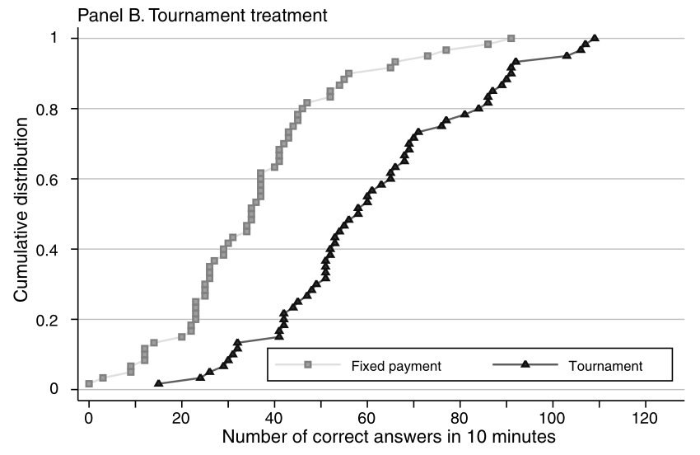
Results · Output · Numbers
The tournament scheme is significantly higher than that under the fixed-wage regime.

Slide 31
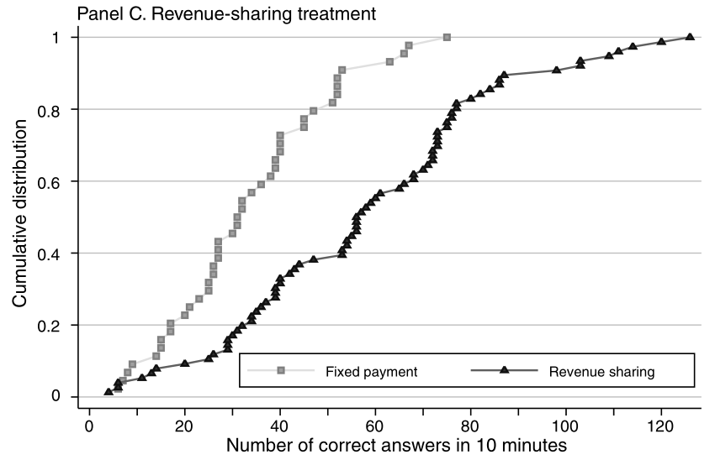
Results · Output · Numbers
The revenue-sharing scheme is significantly higher than that under the fixed-wage regime.

Slide 32
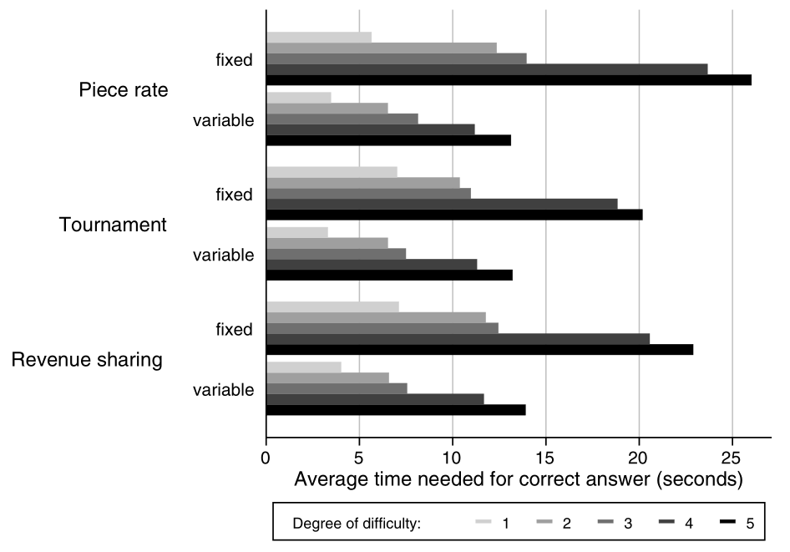
Results · Output · Time
All variable-pay shemes are significantly higher than that under the fixed-wage regime.

Slide 33
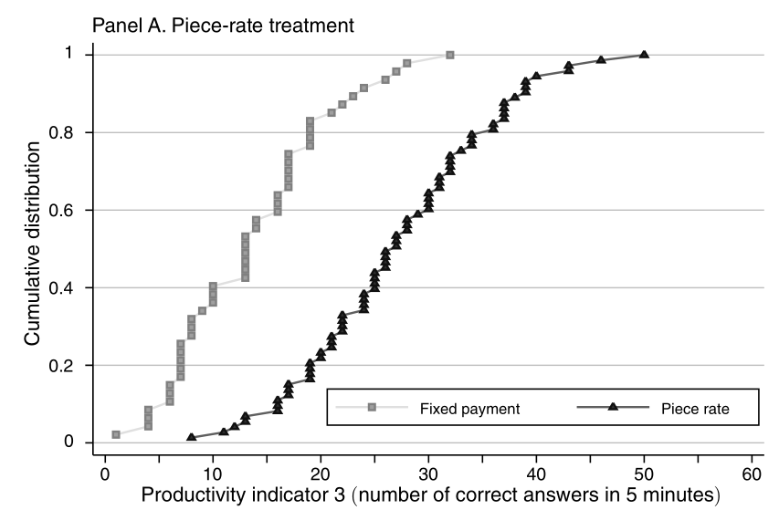
Results · Sorting · Productivity
the more productive a worker, the more likely he self-selects into the variable-pay scheme.

Slide 34
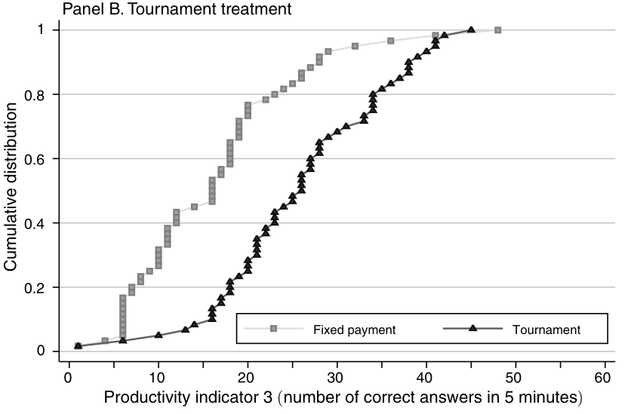
Results · Sorting · Productivity
the more productive a worker, the more likely he self-selects into the variable-pay scheme.

Slide 35
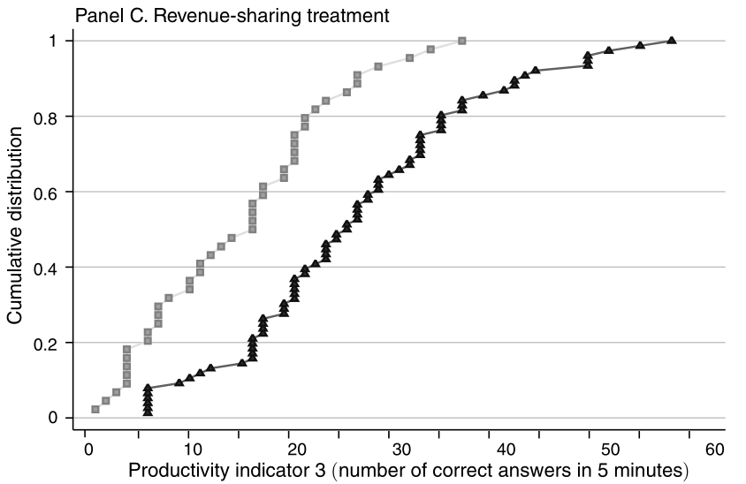
Results · Sorting · Productivity
the more productive a worker, the more likely he self-selects into the variable-pay scheme.

Slide 36
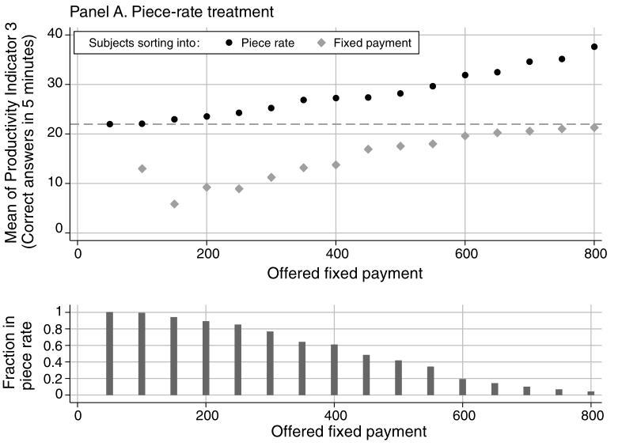
Results · Sorting · Productivity
Sorting pattern: As the fixed wage becomes more attractive, fewer and fewer subjects self-select into variable pay.

Slide 37
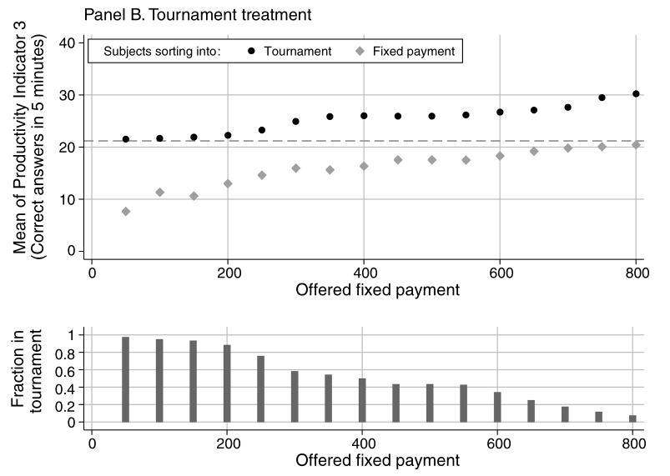
Results · Sorting · Productivity
Sorting pattern: As the fixed wage becomes more attractive, fewer and fewer subjects self-select into variable pay.

Slide 38
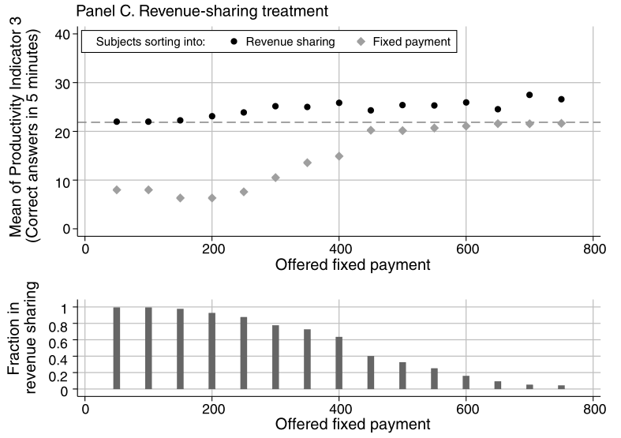
Results · Sorting · Productivity
Sorting pattern: As the fixed wage becomes more attractive, fewer and fewer subjects self-select into variable pay.

Slide 39
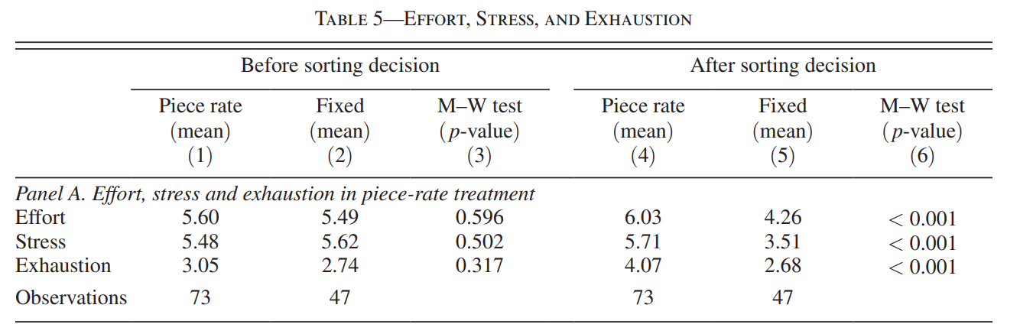
Results · Effort Provision
Before sorting decision: five-minute test for productivity indicator in step 3
After sorting decision: ten-minute under different schemes

Slide 40
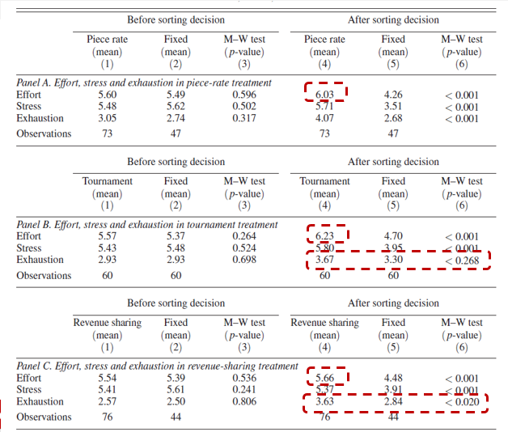
Results · Effort Provision
Notes:
1.把计件，锦标赛和收入分享机制放到一起会发现锦标赛制度下努力程度的变化最大，收入分享机制下最小，后文也讨论说收入分享机制确实选择时间最长，有更多的考量而不仅是对激励制度的考量
2.同时选择可变工资的人更容易疲惫，但是并不显著

Slide 41
Results · Sorting · Risk attitudes
Elicit risk attitude on an 11-point scale.
How do you see yourself: “Are yougenerally a person who is fully prepared to take risks or do you try to avoid taking risks? Please tick a box on thescale, where the value 0 means: ‘unwilling to take risks’ and the value 10 means: ‘fully prepared to take risks’.” (by 2004 wave of the German Socio-Economic Panel Study)
Answer these questions on a seven-point Likert scale.
0: unwilling to take risks
10: fully prepared to take risks

Slide 42
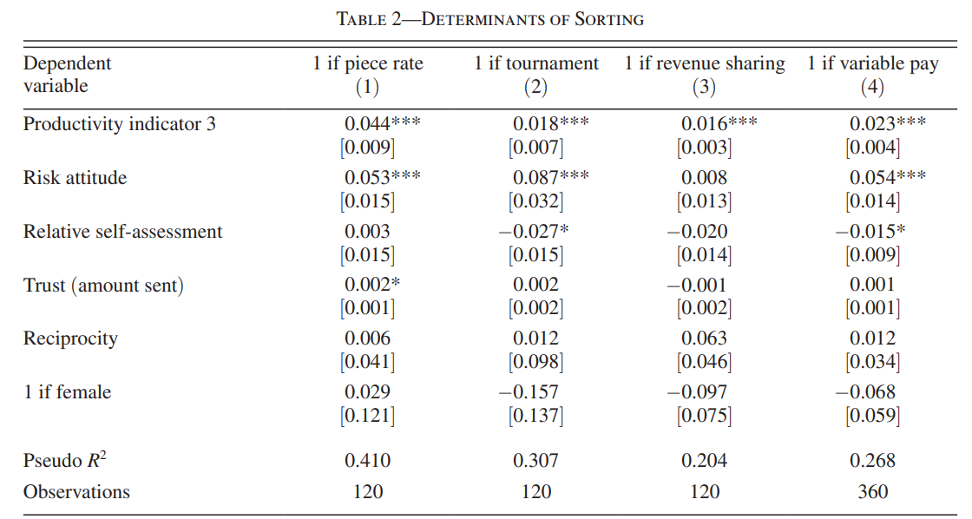
Results · Sorting · Risk attitudes
Risk-seeking subjects are more likely to self-select into variable-pay schemes(piece rates and tournaments)
Notes:
col.(1)&(2): risk-averse workers are less likely to self-select into piece rates and tournaments.
col.(3): No such effect is observed for the revenue-sharing treatment.
col.(4): Pooling all observations from all conditions yields a significant coefficient of 5.4 percent.

Slide 43
Results · Sorting · Relative self-assessment
Assessed performance in step 3 relative to others’ performance.
How many of the other 19 participants solved more questions than you did?
Have incentives to answer accurately.
a correct estimate: 100 points
a estimate within 1: 50 points
other conditions: 0 points

Slide 44
Results · Sorting · Relative self-assessment
Controlling for productivity, the impact of self-assessment is significant in the tournament schemes.
Notes:
Controlling for productivity, the impact of self-assessment on the sorting decision is significant in the tournament schemes, but is insignificant in the piece-rate & revenue sharing schemes
Subject with a more positive self-assessment of one rank is about 3 percent more likely to enter the tournament than a less optimistic but equally productive subject
If a subject can be classified as overconfident if he or she overestimates his or her true rank, these results also suggests that overconfident subjects are more likely to select into tournaments

Slide 45
Results · Sorting · Social preferences
Elicit social preferences using a simple Trust game.
A two-player,sequential game
(1) contingent response method
(2）the actual transfer
(3）both roles required
(1) transfer amount {0,20,40,60,80,100,120}
(2) tranfer tripled; tranfer any amount[0,480]
the first mover
endowment:120 points
the second mover
endowment:120 points
More details see: Berg et al.(1995)

Slide 46
Results · Sorting · Social preferences
Neither trust or reciprocity significantly determine the sorting decision(except for a small effect for trust in the piece-rate treatmen).
Notes:
Variable: Trust & Reciprocity-all subjects participated in a Trust game in both roles as first and second mover

Slide 47
Results · Sorting · Gender
Gender does not significantly affect the choice between the fixed payment and the variable pay alternative in any treatment.
Notes:
Gender does not significantly affect the choice between the fixed payment and the variable pay alternative in any treatment, conditional on productivity, risk attitudes, relative self-assessment, and social preferences

Slide 48
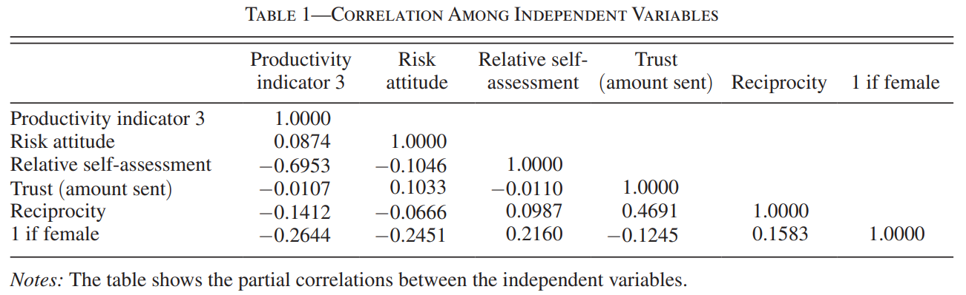
Results · Sorting · Gender
If there are important gender differences in attributes
we condition on
affect the sorting decision
gender differences in sorting choices might be reflected in a significant estimates of gender specific attributes.
Notes:
如果在个人特征中有显著的性别差异，那么在分类中的性别差异不会在性别哑变量的系数中体现出来，但会在有性别差异特征的显著系数中体现

Slide 49
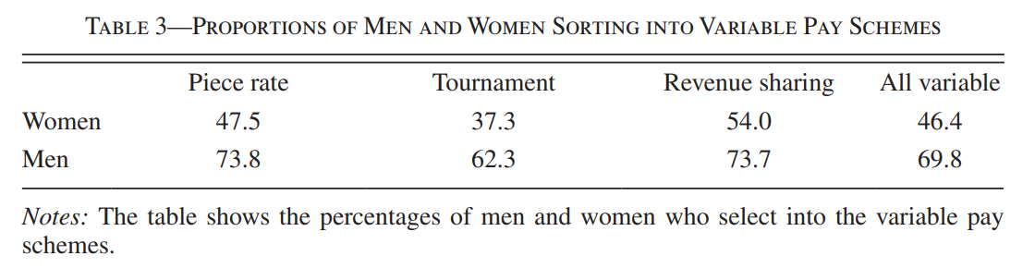
Results · Sorting · Gender
Gender difference is very strong in the piece-rate & tournament treatment, and somewhat smaller in the revenue-sharing treatment .

Slide 50
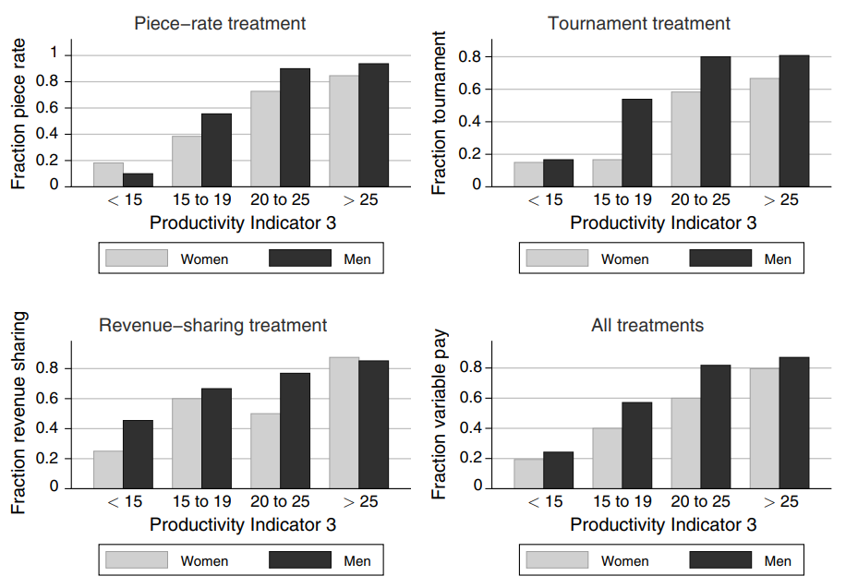
Results · Sorting · Gender
only condition on productivity
Notes:
用生产力指标3进行分类：少于15个，15-19个，20-25个以及超过25个问题被解决
1.比如左上角在计件工资这里，生产力同样为15-19的男性有接近60%选择灵活工资支付，同样生产力的女性只有40%选择灵活工资支付
2.在右下角可以看到将所有处理组混合起来，同一生产力水平上男性选择灵活工资的比例都高于女性

Slide 51
PART 4: Discussion
Outside the lab
Main results
Implications

Slide 52
Discussion: Outside the lab
Whether sorting patterns in the lab generalize qualitatively to labor markets outside the lab
Data from German Socio-Economic Panel Study
Cautious about the interpretation of field data
suggesting the importance of multidimensional sorting.
Notes:
1.现在关心的是实验室的结论在现实的劳动市场中是否成立？
2.正好有德国社会经济的面板数据，将受教育年限，全职工作经历及兼职工作经历和任期作为生产力的代理变量，对于风险态度和信任都有度量

Slide 53
Discussion: Main Results
Testing the traditional: Productivity→Sorting decision
More dimensions: risk attitudes, relative self-assessment, gender
Gender differences maybe due to risk attitudes and productivity differences
Importance of preferences and attitudes on the sorting decision depends on the type of variable incentives
Notes:
1.生产力更高的员工更容易选择可变工资支付制度，这对计件工资，锦标赛和收入分享机制是一样的，这一点结论也是前人研究中大量涉及的，本文只是做了一个检验
2.但是生产力只是影响选择的一种因素，本文探讨了多个维度的其他因素，比如风险态度的影响，风险规避的人更愿意选择固定工资，对自己的相对评价越高越可能选择锦标赛制度
3.女性选择可变工资制度的可能性较低，可能是因为女性更多风险规避且生产力较低
4.对于处在不同生产力水平的人，风险态度及相对评价对于分类选择的影响可能不同
5.生产力对于三种可变工资制度的选择都是很重要的，但是偏好和风险态度对于收入分享机制的选择作用不稳健，有两点原因
·由于做出收入分享机制的选择所花时间最长，表明这个决定的确很难
·对于收入分享机制的人，产出方差比其他两种可变工资制度大，说明收入分享机制中激励结构比其他两种更复杂

Slide 54
Discussion: Implications
Designing incentives: not only focus on effort effects but also consider self-selection.
Offer different career paths to get right people on the right job.
Safety officers should be risk-averse to downside risk for the firm
In reality, firms can adjust the relative weight of variable pay.
Also have implications for gender wage gap.
Notes:
现实中无法观测到风险态度，可以通过求职者对于激励机制的选择显现出他们的风险态度
现实中不必要绝对采取固定或是灵活，可以有底薪再根据业绩加成的制度
由于工资的性别差异在现实中也有较多的内生性问题，本文通过实验发现性别工资差异部分是通过风险态度影响职业选择引起的

Slide 55
Discussion: thoughts
Incentive effects or sorting effects?
Learning effects?
Notes:
现实中无法观测到风险态度，可以通过求职者对于激励机制的选择显现出他们的风险态度
现实中不必要绝对采取固定或是灵活，可以有底薪再根据业绩加成的制度
由于工资的性别差异在现实中也有较多的内生性问题，本文通过实验发现性别工资差异部分是通过风险态度影响职业选择引起的

Slide 56
Thanks for listening :)

